Slide 1
Improving Lead Conversion Rate for X Education platform
Project work – upGrad Campus
By,
Gopi Bollineni
UGC-DA-2651

Slide 2
Table of Contents
Improving Lead Conversion rate for X-Education platform
Objective
Background
Key findings
Recommendations
Appendix:
Data Sources
Data methodology
Data model assumptions

Slide 3
Objective
Improve our shared understanding of the metrics and variables that lead to good conversion rates.
Improve our shared understanding about the prospects.
Provide early recommendations to our marketing and sales teams

Slide 4
Background
The lead conversion rates previously have been around 38%.
Several data points that have been collected indicate that prospects with certain characteristics can be focused upon in order to increase the lead conversion rates.
However, these features or data characteristics that need extensive focus need to be determined through analysis and recommended to the sales team.

Slide 5
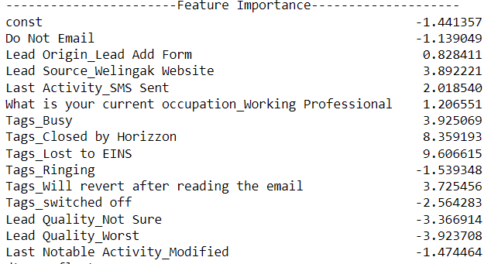
LESS FOCUS ON SEVERAL VARIABLES OF THE DATA IS PRESSURISING THE LEAD CONVERSION RATES
‘Tags’, ‘Lead Quality’ and ‘Lead Source’ features are the top three variables that are highly affecting the conversion rates.
The ‘Lead counts’ and lead conversion rates in several of the variables can be focused upon in order to improve the overall lead conversion rates.
The following snippet consists of the variables against their feature importance coefficient in terms of their contribution towards the conversion rates(the farther away from zero, the more important is the feature).

Slide 6
TOP CAUSES FOR LOW CONVERSION RATE
Unable to detect the prospect engaging segments.
Unavailability of mechanisms to detect marketing channels that are responsible in high conversion rates.
Uncertainty about focusing upon highly effective channels.

Slide 7
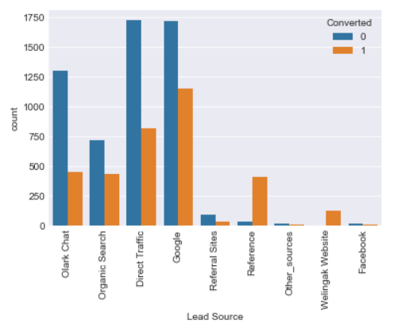
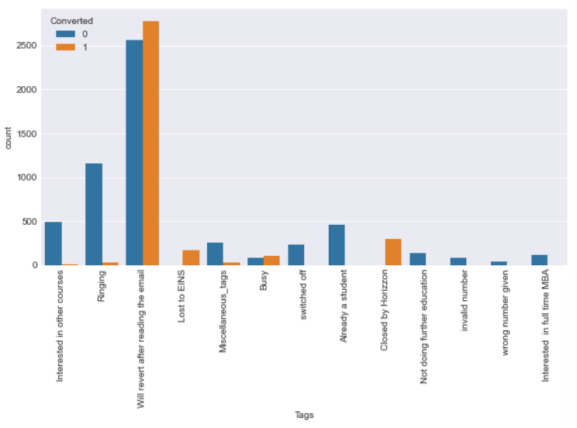
ONLINE LEAD SOURCES AND EMAIL CHANNELS HAVE A HIGH CONVERSION RATE
‘Google’, ‘Direct Traffic’, ‘Olark Chat’ and ‘Organic Search’ lead sources are lead sources with highest conversion rates
The ‘Tags’ feature indicates that most prospects prefer the email mode of communication for the enrollment and course related information.

Slide 8
RECOMMENDATIONS
Focus efforts on improving the lead counts and lead conversion rates in the certain designated sales channels.
Reduce focus on unfruitful sales channels.
Improve customer experience.

Slide 9
APPENDIX – DATA SOURCES
Here is a snapshot of our data dictionary:
Prospect demographics such as gender, occupation, education specialization and salary.
Prospect preferences.
The team used the following data sources:
CRM data
Prospect feedback data

Slide 10
APPENDIX – DATA METHODOLOGY
We conducted a thorough analysis of the lead conversion dataset. The process included:
Cleaning the data set using fuzzy logic
Creating visualizations to compare various sales channels and their effectiveness.
Using the data caping method to remove outliers.

Slide 11
APPENDIX – DATA ASSUMPTIONS
There were certain gaps due to data unavailability. Therefore, the following assumptions have been made.
The features ‘Asymmetrique Activity Index’, ‘Asymmetrique Profile Index’, ‘Asummetrique Activity Score’ and ‘Asymmetrique Profile Score’ do not have any significance in our analysis.
NULL values in the ‘Lead Quality’ have been assumed to be under the ‘Not Sure’ category.
A few classes in several sales channels that were determined to be less significant have been grouped under one category.

